Slide 1

Training Grant
Financial Award Management
Policy
Jill I. Vampola
Training Grant Analyst
Research Service Core
August 10, 2023

Slide 2
Today’s Objective
Recap last week
Understand training grants award management policy

Slide 3
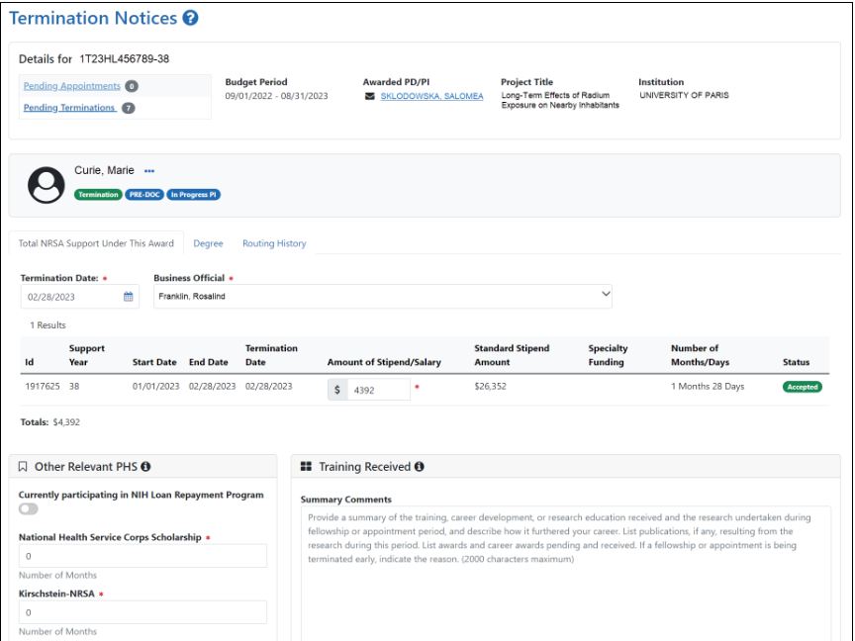
xTRAIN Terminations

Slide 4
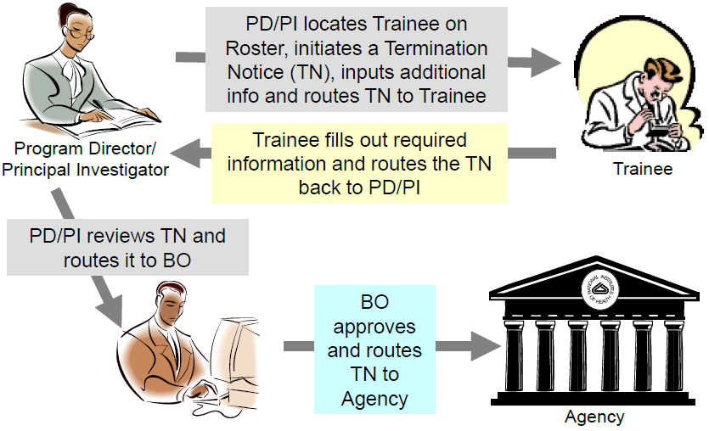
xTRAIN Termination Process
In Progress PI
In Progress Trainee
In Progress by BO
Pending Agency Review
Accepted

Slide 5
Award Set up

Slide 6
Four Categories
Training Related Expenses (TRE)/Institutional Allowance
  Travel
Trainee Stipends
Trainee Tuition/Fees
Childcare Costs
8% Burden Rate

Slide 7
Award Set up
Award
Project
Task 1
Training Related Expenses
Task 2
Stipends
Task 3
Tuition and Fees
Task 4
Childcare Costs

Slide 8
Notice of Award

Slide 9
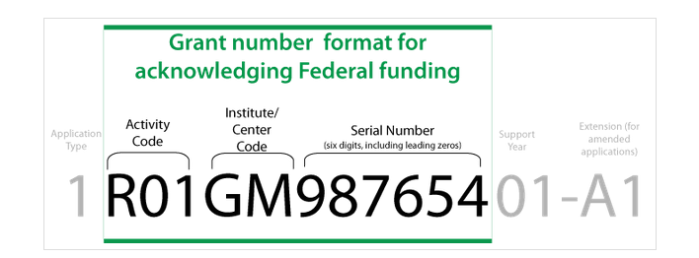
Deciphering a NIH Grant
Notes:
Where to put this slide? Post award?

Slide 10
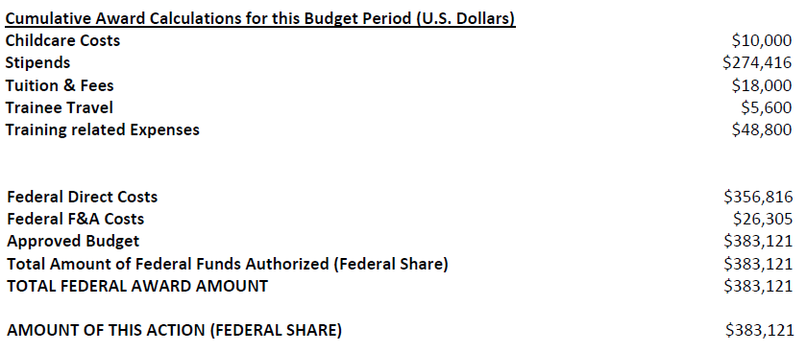
Standard Notice of Grant Award
Tre Task

Slide 11
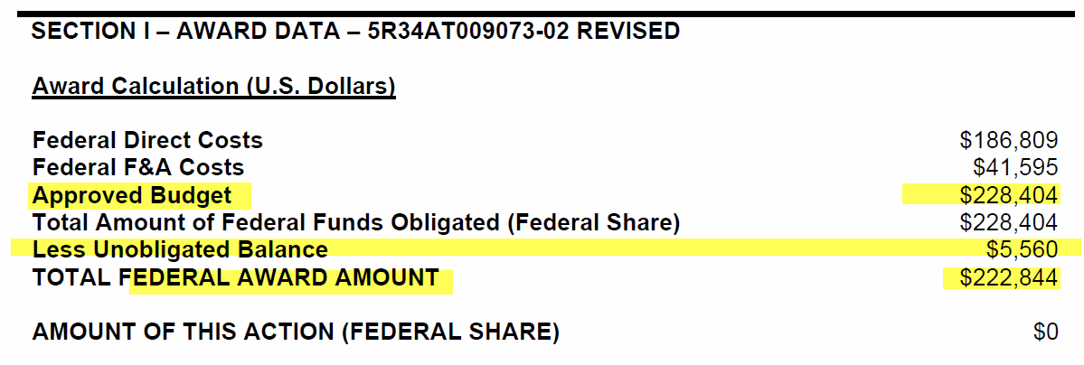
Notice of Grant Award with Unobligated Balance
Unobligated balance from previous year. It can be to offset current budget year, or, it can increase the budget for the current year.

Slide 12
Training Related Expenses

Slide 13
Training Related Expenses
  Predoc Trainee Health Insurance
  Admin Salaries
  Meeting meals
  Speaker Fees
  Supplies
Cannot be carried forward to next budget year

Slide 14
Travel

Slide 15
Travel
Allocated in the training related expenses task
Travel not booked in budget period is usually not allowed. IC approval would be required
  Trainees must be appointed to the TG at time of the actual travel
Trainee travel is not considered a trainee cost and, therefore, may be rebudgeted into any other budget category without prior approval

Slide 16
Stipends

Slide 17
Stipends
Expenditure Code
  511002 - Graduate and Postdoc Aid/Fellowship
8% IDC (burden rate) is accessed

Slide 18
Postdoc Benefits

Slide 19
Postdoc Benefits
Postdoc Benefits post to the stipend task
All postdoc benefits need to be moved off the stipend task to the TRE Task via a benefits cost transfer in UC Path
The unallowable benefits are moved to unrestricted non-federal funds provided by the department or mentor

Slide 20
Due to Composite Benefit Rates (CBR), the following benefit expenses do not have its own expenditure type
Benefits Account Codes
Allocability on Training Grants
Dental Insurance – PSBP
Health Insurance PSBP
Vision Insurance - PSBP
Disability Insurance – PSBP*
Life Insurance – PSBP*
Broker Fees – PSBP
State Worker’s Comp Ins*
Yes – but must be moved to TRE task
Yes – but must be moved to TRE task
Yes – but must be moved to TRE task
No – must be moved to an unrestricted fund
No – must be moved to an unrestricted fund
Yes – but must be moved to TRE task
No – must be moved to an unrestricted fund

Slide 21
Postdoc Benefits
Composite benefit rate (CBR) – currently for postdocs is 21.3%
If charged the full rate, 6.4% is moved off

Slide 22
NGN and HSIT Charges

Slide 23
NGN Charges
NGN must be moved from the stipends task to training related expenses
Redirect for each trainee at the start of the appointment contact ITS at https://support.ucsd.edu/its
If it is not redirected, then these charges are moved via a direct retro
Account Number / Expenditure Type
  770002 - NGN Communication Recharge

Slide 24
HSIT Charges
Health Sciences IT (HSIT) Charges are allowable on training related expenses task
HSIT must be moved from the stipends task to training related expenses
Account Number / Expenditure Type
  772013 - VCHS Shared Svc HIST
  770001 - HSIT VCHS Shared Svc

Slide 25
Tuition and Fees

Slide 26
Tuition and Fees
Generally for predocs, but (some clinical) postdoc programs have CREST courses
Tuition and Fees Financial Aid and Scholarship Expenses Expenditure types
  510000 - Undergrad Financial Aid Odd Year
  510000 - Undergrad International Student Aid
  510001 - Undergrad Financial Aid Even Year
  510002 - Undergrad Tuition and Fees
  511000 - Graduate Financial Aid Odd Year
  511001 - Graduate Financial Aid Even Year
  511003 - Graduate Tuition and Fees Code
IDC is NOT assessed

Slide 27
Childcare Costs

Slide 28
Childcare Costs
Short-term trainees are not allowed
Any unused funds cannot be rebudgeted and must be reported as an unobligated balance
Expenditure type
  507405 - Fellow Child Care Cost
NIH will offset any unused funds in future years or will adjust the amount as a part of the closeout process
IDC is NOT assessed
ChildCare Costs for NRSA Awards
SPF Guidance

Slide 29
Rebudgeting

Slide 30
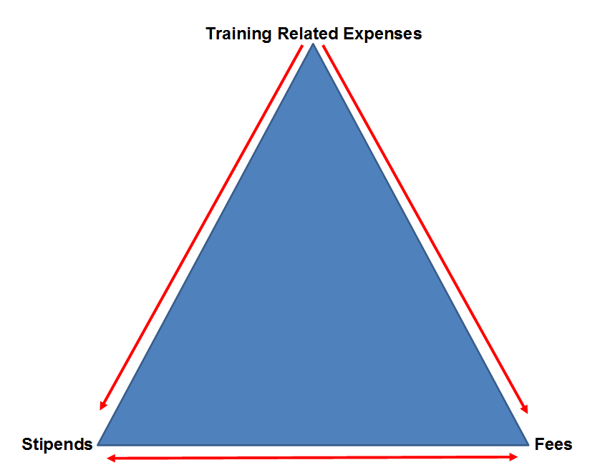
Re-budgeting Guidelines
Allowed to move down
Allowed to move across
Not allowed to move up
Childcare Cost

Slide 31
Rebudgeting
Can tuition & fees be re-budgeted to training related expenses?
No
Can stipends be re-budgeted to training related expenses?
No
Can stipends be re-budgeted to fees?
Yes
Can fees be re-budgeted to stipends?
Yes
Can training related expenses be re-budgeted to stipends and/or fees?
Yes

Slide 32
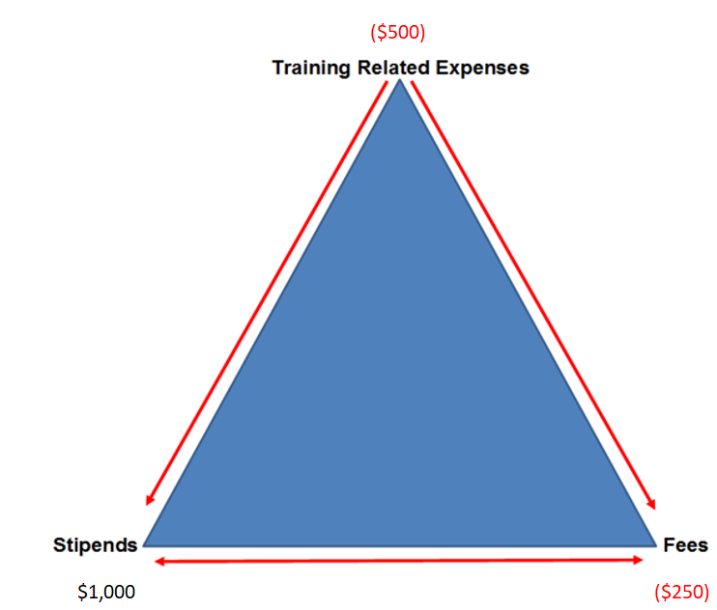
Rebudgeting
What is the FER balance?
TRE= -$500
Fees = -$250
Stipends = $1000
Re-budget $250 from stipends to cover deficit in fees. $1000 - $250 = $750
-$500 is moved off to unrestricted funds
True FER balance in this example = $750

Slide 33
Rebudgeting
A balance in stipends and/or fees mean:
It will need to be reported to the agency – even if the overall fund is in deficit
A balance in stipends and/or fees cannot be used to cover the deficit in training related expenses
  Only if you receive written approval from NIH

Slide 34
Unliquidated Expenses/Obligations

Slide 35
Unliquidated Expenses/Obligations
Portions of stipends & tuition that extend beyond the budget period are carried over as unliquidated expenses/ obligations
Not restricted
Expenses incurred but not paid within the budget period

Slide 36
Unliquidated Expenses/Obligations
  Stipends
  Tuition and Fees
Predoc and Postdoc Benefits in TRE Task
Childcare Costs

Slide 37
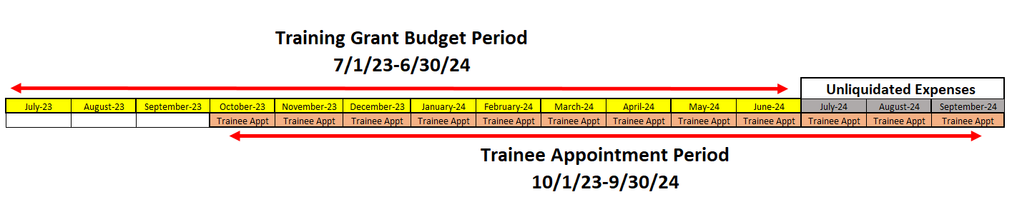
Budget Periods VS Appointment Periods
  Trainees can be appointed anytime during the budget period
Trainee stipends and tuition are obligated for the full 12-month appt from the budget period in which the appt. is initiated
Know your budget start and end dates to effectively manage trainee appts

Slide 38
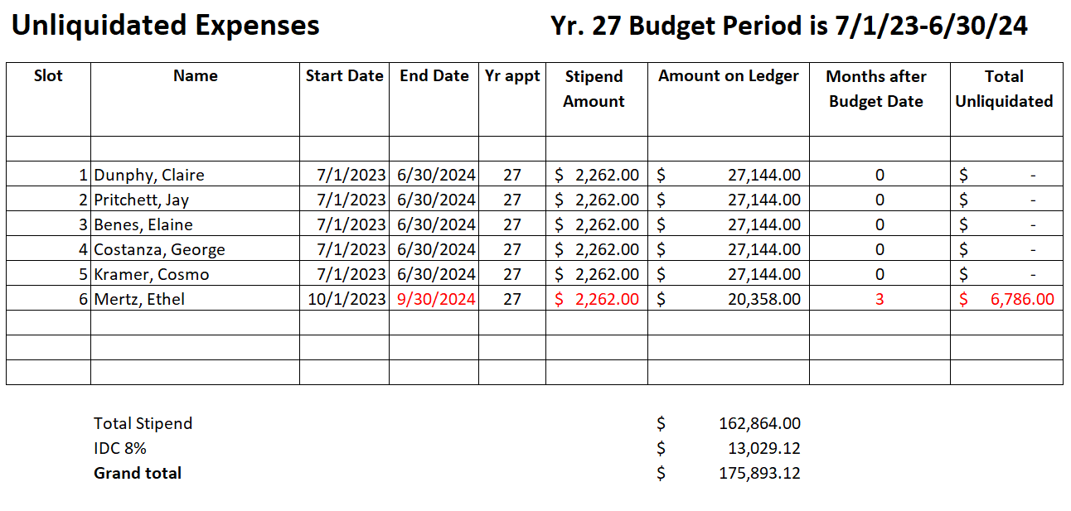
Unliquidated Expenses/Obligations
Use the same method for fees and/or health benefits

Slide 39
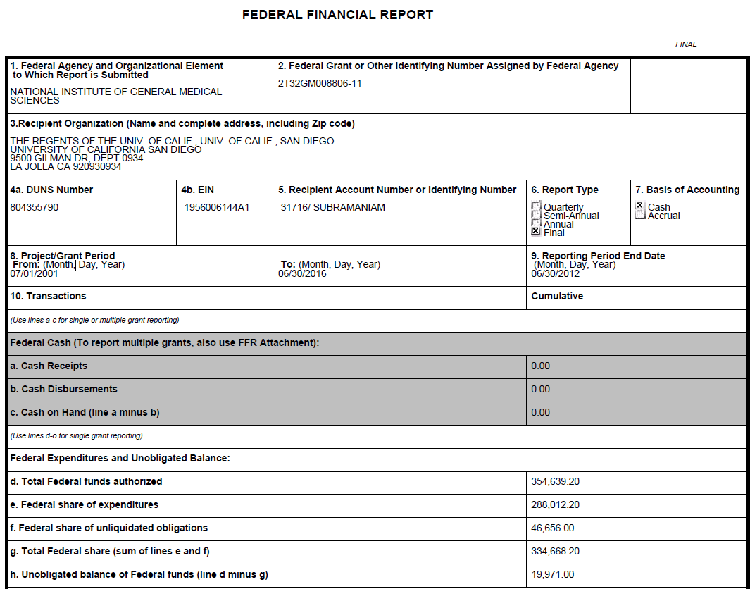
Unliquidated obligations/expenses on FFR

Slide 40
Unobligated Expenses

Slide 41
Unobligated Expenses
Automatic carryover IS NOT permitted on training grants
Unspent Allocation
Will be restricted

Slide 42
Unobligated Expenses on FFR

Slide 43
Summary by Training Grant Budget Category
Category | IDC | Expenditure Types | Report as Encumbrance | Rebudget without IC approval
Training Related Expenses | Yes | 5XXXXX other than the expenditure types from other categories below | No | To Stipends and Tuition & Fees
Stipends | Yes | 511002 - Graduate and Postdoc Aid/Fellowship | Yes | To Tuition and Fees only
Tuition & Fees | No | 510000 - Undergrad Financial Aid Odd Year 510000 - Undergrad International Student Aid 510001 - Undergrad Financial Aid Even Year 510002 - Undergrad Tuition and Fees 511000 - Graduate Financial Aid Odd Year 511001 - Graduate Financial Aid Even Year 511003 - Graduate Tuition and Fees Code | Yes | To Stipends only
Childcare Costs | No | 507405 - Fellow Child Care Cost | Yes | No

Slide 44
No office hours
8/17/2023
*Staff Picnic*

Slide 45

Q & A

